Slide 1
4. Federalism
Breakout Sessions
POLS 1101
12:40pm-1:30pm Park Hall 145
& 1:50pm-2:40pm Leconte Hall 135
SIYUAN (Siri) ZHAO
Siri.Zhao@uga.edu
Notes:
Today we re going to talk about

Slide 2
Theories
Dual federalism: The powers of the national government and the states are clearly distinguished.
  Delegated powers
  Reserved powers
Cooperative federalism: Different levels of governments work together to serve people’s needs.
Ideal types! Reality is a mix-up of them.
Coercive federalism: The national government imposes its policy preferences on the states.
  Mandate: A requirement that a state undertake an activity or provide a service in keeping with minimum national standards.
  Restraint: A requirement prohibiting a state or local government from exercising a certain power.
  A relative to cooperative federalism?

Slide 3
How can actual federalism be influenced?
Judicial interpretation
  Recall: Actual lawmakers vs. Essential discretional power
Grants-in-Aid: Money, money, money!
  Categorical grants, Block grants
  Formula grants, Competitive grants
National crises and demands
  Inadequate state capacities
Professionalization of state governments
  Strong state capacities
How to define state capacities, is really a difficult question, which can impact the result of games between the national and state governments.
Notes:
Specific purposes vs. general ones
Distributed according to some rules vs. compete for the grant
Regular tasks

Slide 4
Ideas, Policymaking, and Federalism
Recall: The major differences between liberals & conservatives lie in their views toward the purpose of the government (socio-economic description). – so do not put an ideological hat on others casually.
In reality, conservatives do not always support the expansion of the state power, or liberals insistently for national power. The key here is still what the national / state power is used for.
  Can you provide some counterintuitive examples?
Preemption: the power of Congress to enact laws by which the national government assumes total or partial responsibility for a state government function.
  Do you think there are some powers that must be retained in the states? If you do, what are these powers?
  Should preemption allow states to set higher standards, rather than always replacing them? (the marijuana example)

Slide 5
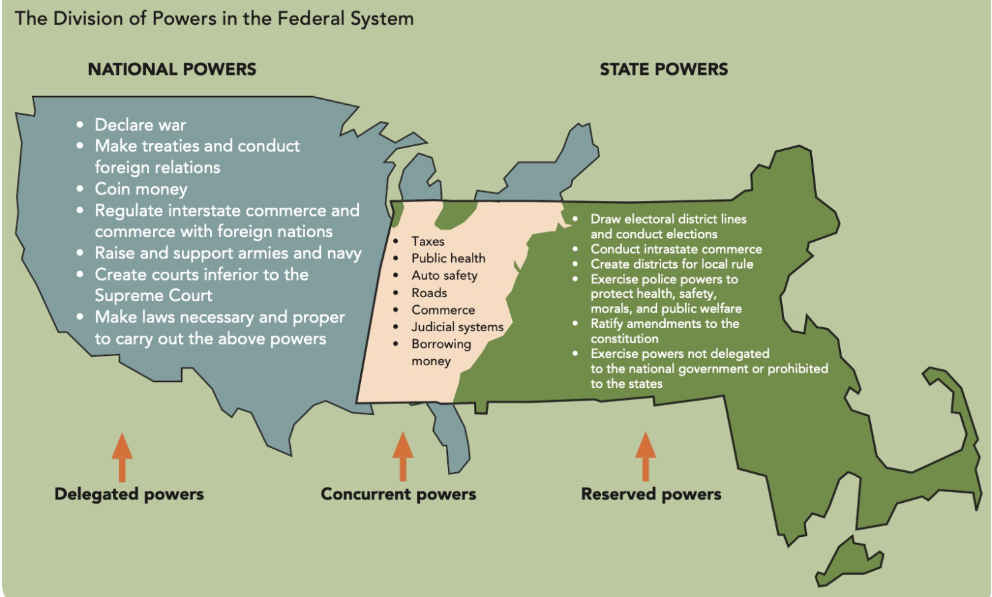

Slide 6
Advantages and Disadvantages of Federalism
One puzzle where so-called “common sense” failed
  Generally predicted, local government is closer to the people who can participate in the political process and directly influence policy, so they’ll be passionate about voting in local elections, regardless of their ideologies, party identities, etc.
  Actually, people are much less likely to vote in state and local elections. –Why?
    Remark: A great study starts from the deviation of a theory from reality!
    Dispersed power -> little publicity for local elections, nonpartisan local affairs -> less prominent races, less clearly recognizable identity labels -> political apathy
    Dispersed power -> complicated government structure, higher requirement for political participation -> incomprehensible and unavailable for ordinary people -> political apathy
    Therefore, more participation opportunities do not lead to majoritarian demo, but to pluralist democracy -> an possible explanation of the intension between the majority rule and the pluralist reality.
    Anyway, federalism provides more flexibility!

Slide 7
Next week…
Read materials on Civil Liberties before class, and that will be helpful to participate in peer discussions.
Next class will be the last one before 1st exam, so we can go over some basic concepts together (actually we’ve been doing it! We’ll pay more attention to slides.)
Feel free to email me if you have any questions!
ENJOY YOUR WEEKEND!

